Slide 1
NAO Night #1

Slide 2
About
These sessions are for hands on experience with the robots
To help develop skills and problem solving when it comes to programming the nao robots
To have fun :)

Slide 3
Prerequisites
Have taken Programming 1, or have coded anything
Know the bear minimum of Object Oriented Design
Have your own computer that is connected to the WIFI
If you don’t meet these, don’t worry! Just try to follow along and pick up a couple of things

Slide 4
What we will cover
Introduction
Installing Python, NAO SDK
IDEs
Hello world
Documentation
Movement
Virtual robot
Taking care of the robot

Slide 5
Introduction
https://www.youtube.com/watch?v=oBHYwYlo1UE
https://www.youtube.com/watch?v=p1ITwOEZAdA
https://www.youtube.com/watch?v=RjSw6xpucnM

Slide 6
Installing Python 2.7 32 bit
goo.gl/nd2scm
Avoid the X86-64 MSI installer (that is 64bit)
(Look in your inboxes for the stuff you need to install)

Slide 7
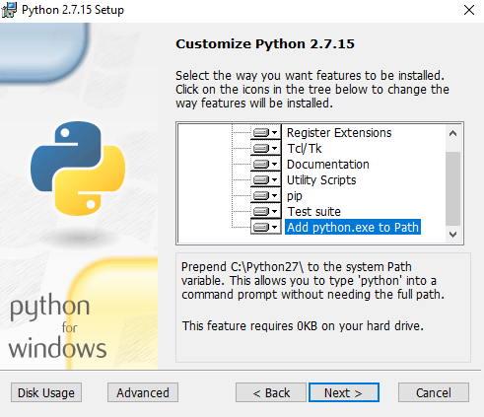
Make sure to add Python.exe to your Path
If you missed this during installation:
Run the install again, and click “Change”

Slide 8
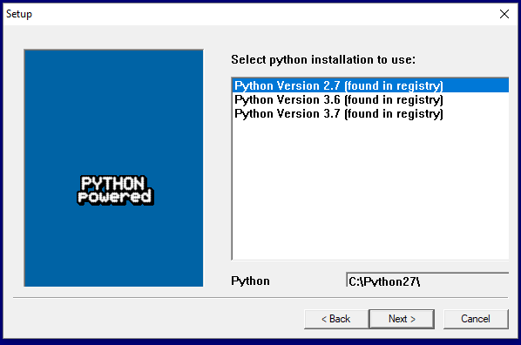
Installing NAO SDK
Copy short URL
Copy short URL
goo.gl/Uids9P
make sure you selected 2.7 while installing

Slide 9
Python IDEs
PyCharm (heavier)
www.jetbrains.com/pycharm/
Sublime Text (light)
www.sublimetext.com
IDLE
Built in

Slide 10

Hello World
Import the nao SDK into python

Slide 11

Getting the Robot’s IP and Port
Just press the chest button once and it should say its IP
The default port is: 9559
Put those two values in variables
IP is a string
Port is an int

Slide 12

Creating our Proxy object
There are a bunch of different things that you can do with the robot
Broken down into different “modules” or proxies
We are going to use the ALTextToSpeech proxy.
ALProxy(module, ip, port)
Returns our proxy object

Slide 13
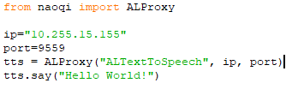
Hello World
Our new object has a method called say
tts.say(“text”)

Slide 14
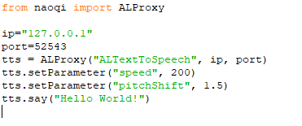
Setting the voice speed and pitch
tts.setParameter("speed", 200) #default 100
tts.setParameter("pitchShift", 1.5) #default 1

Slide 15
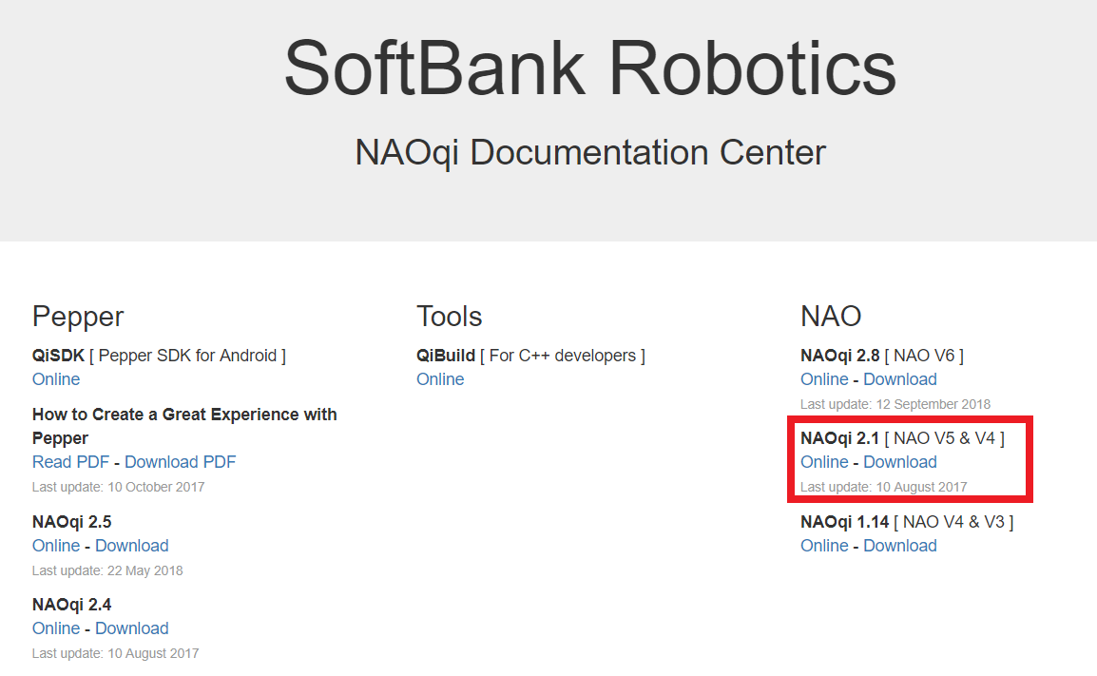
Documentation!
doc.aldebaran.com

Slide 16
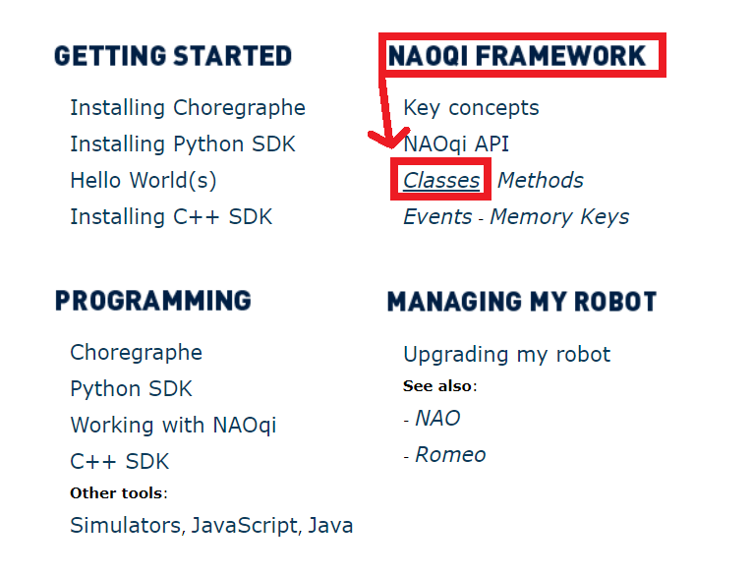

Slide 17
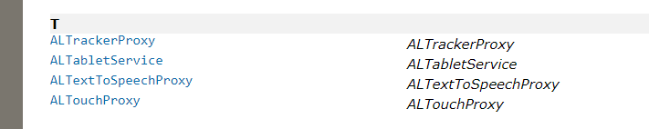

Slide 18
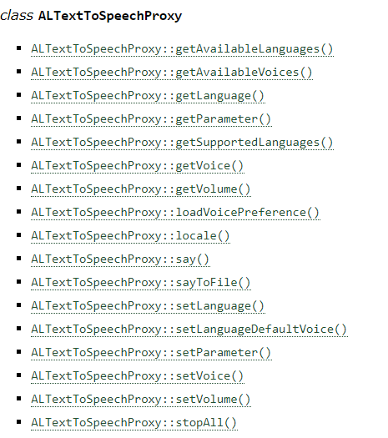

Slide 19
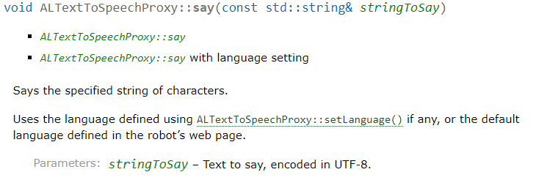
Deciphering what it is saying
return
method
arguments
Overload methods
Description

Slide 20
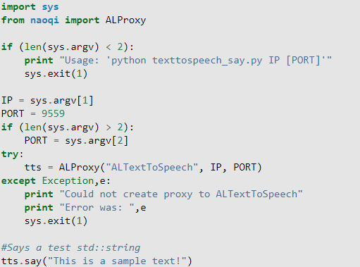
Documentation example
What is all this extra stuff?
They don’t expect you to run it from
your IDE, but rather the command line
or terminal

Slide 21
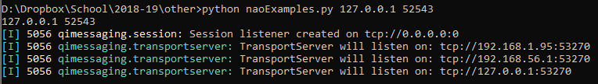
Documentation example

Slide 22
Getting the IP and Port
Connecting
Action

Slide 23
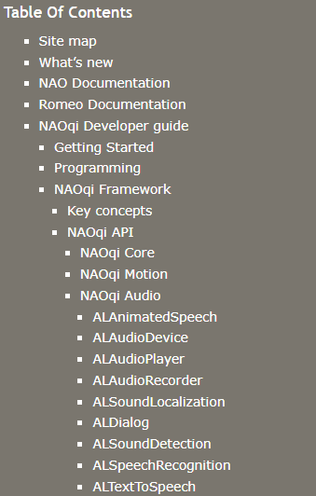
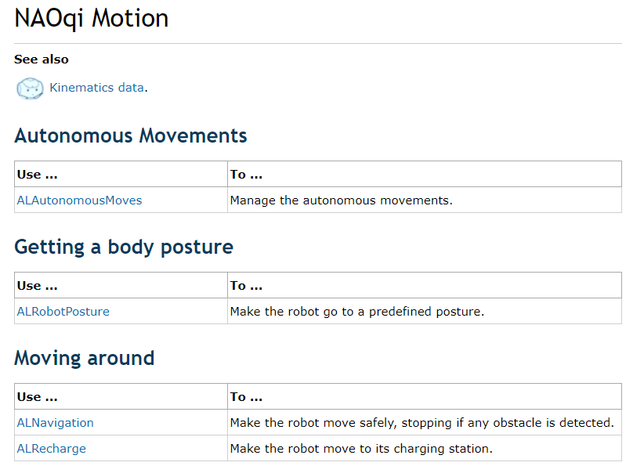
Movement based on documentation

Slide 24
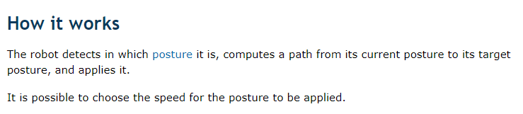
Posture Description

Slide 25
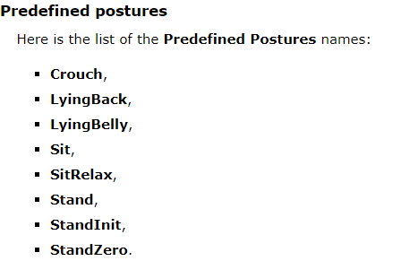
Postures

Slide 26
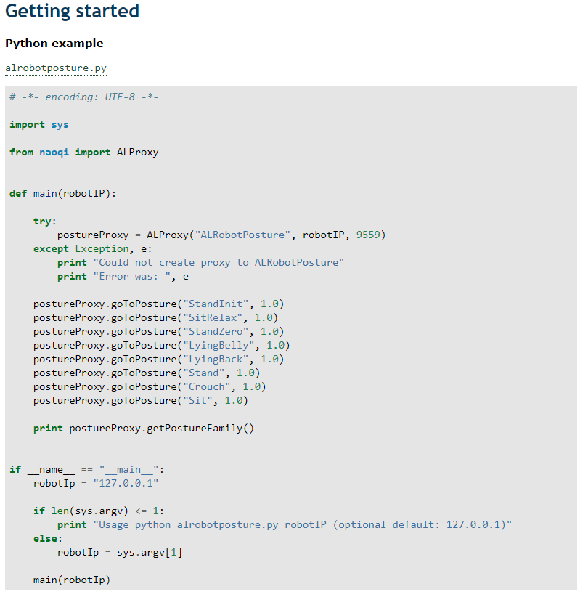
Posture Example code
Let’s NOT run this

Slide 27

Posture simplified example

Slide 28
Virtual robot
Choregraphe
goo.gl/hoqVBL
654e-4564-153c-6518-2f44-7562-206e-4c60-5f47-5f45

Slide 29
Connecting to your virtual robot
Edit -> Preferences
Virtual robot
Change robot model to NAO H21 (V32)
OK
Connection -> Connect to virtual robot

Slide 30
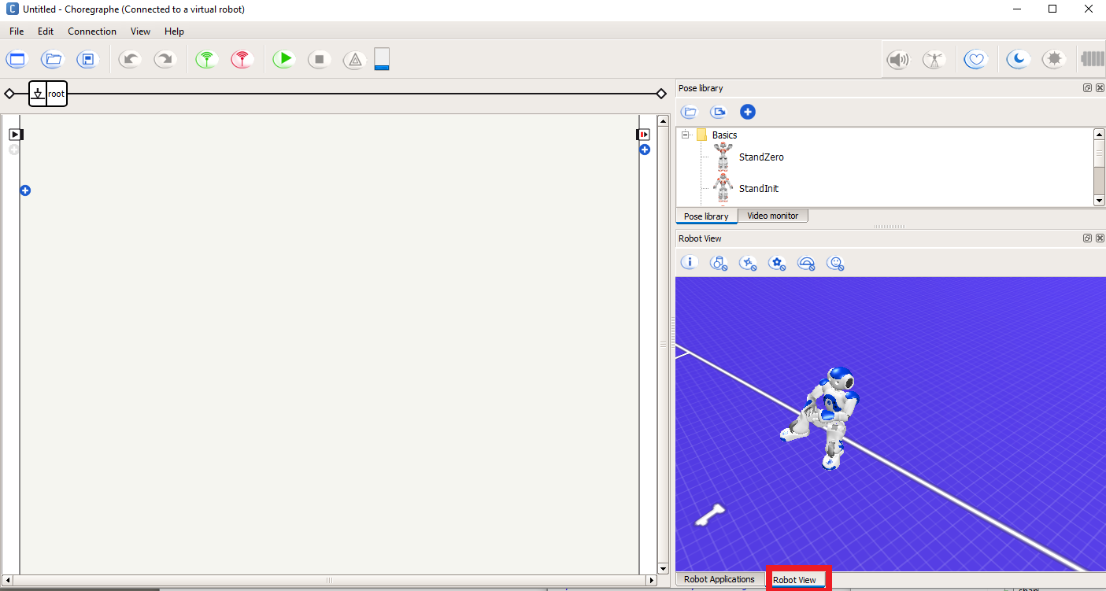

Slide 31
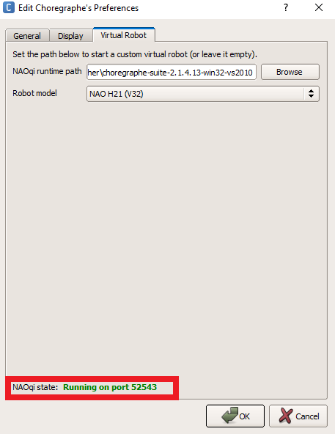
Running programs on the virtual robot
IP: 127.0.0.1
PORT:
Edit -> Preferences->Virtual robot
The port changes every time you restart your virtual robot

Slide 33
Robot Care
Never manually move the robot while it is on!
(Unless you have set the stiffness to 0 on the motors)
Put the robot back in its box when you are done
Don’t leave them sitting in the lab
Please keep them topped off on battery ☺

